Slide 1
In Rememberance
Art Helps us through the difficulties of life

Slide 2
75th Anniversary
75 years ago this week of May 4, 2020, the liberation of the Terezin concentration camp happened. In this lesson we will remember and honor the prisoners of Terezin, and learn from the art, journals, poetry and their personal testimonials.

Slide 3
Friedl Dicker-Brandeis
Art Teacher

Slide 5
Brundibar cast

Slide 6
Office forms as art paper

Slide 7
Beauty Around us

Slide 8
What we see

Slide 12
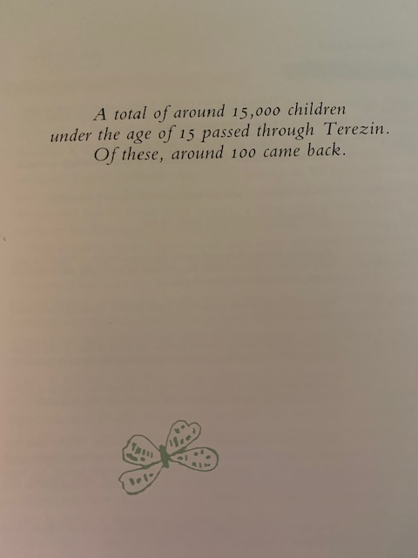

Slide 13
