Slide 1
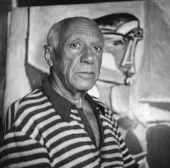
Picasso in 3-d
Cubism at it’s best

Slide 3
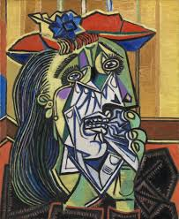
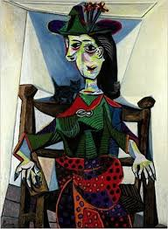
Intro to Project
This project has us looking at Picasso cubism style faces. Facial features often are going in weird directions.

Slide 4
What to do next
Getting the templates
Example of the templates
You will need to go online to either assignments or my website and print out the packet. Choose 2 of the template to print out.
I have also included a page of facial features. That is just for reference.

Slide 5
Choose either Templates 1& 2 or…

Slide 6
Templates 3 &4

Slide 7
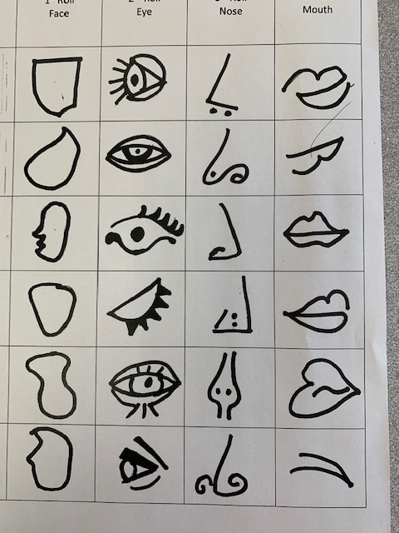
Selection….
If choosing 1 &2 you are simply going to color the templates, and assemble them.
If choosing 3 & 4 you need to add the features before coloring.
This picture is some ideas of what to do for features that are cubismish

Slide 8
Once you have decided
If we were doing this project at school we would be transferring the templates to white poster board, cutting them out and then coloring them with oil pastels.
If you have poster board, go ahead and do that.
If you don’t have poster board, you can print them out, do 2 but one will have to be mirror image, or trace with light box.

Slide 9
Getting the Mirror Image
If you cannot mirror image on your printer, you can trace a mirror image on a lightbox.
If you do not have a lightbox at home to just use your ghetto fabulous lightbox just like we use at school when we don’t have enough!

Slide 10
Getting it onto cardboard
If you did not print it onto posterboard, just glue to cardboard. I used an old cereal box as they are easier to cut.
I also used glue stick, YES, I know the issues with glue stick, but I am in a hurry.

Slide 11
Cutting it out
Once you have side one glued down – contour cut it out

Slide 12
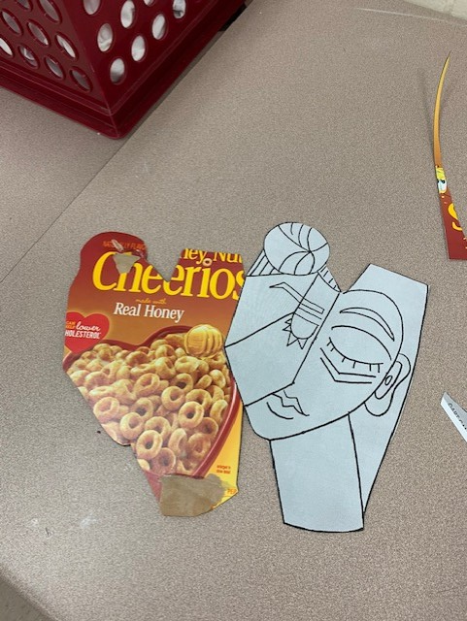
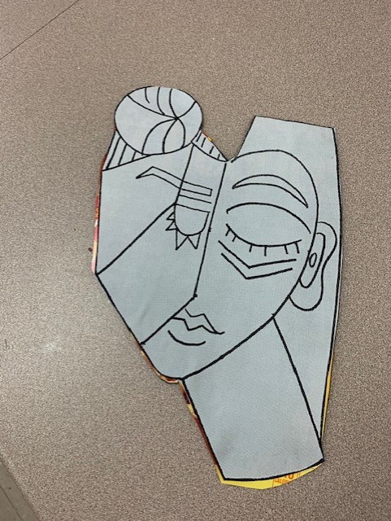
Mirror image onto cardboard
Now you need to get the mirror image on the back
Contour cut out your mirror image picture
Turn over your first cut out to the plain cereal box side, and glue down your mirror image cut out

Slide 13
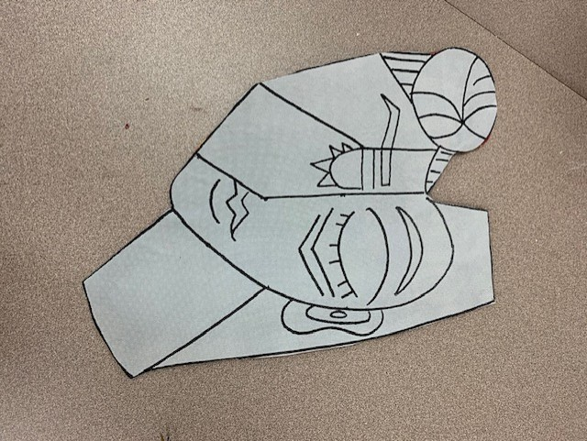
Trimming
Next you need to trim the mirror side so there is no cereal box showing. Compare my 2 pictures

Slide 14
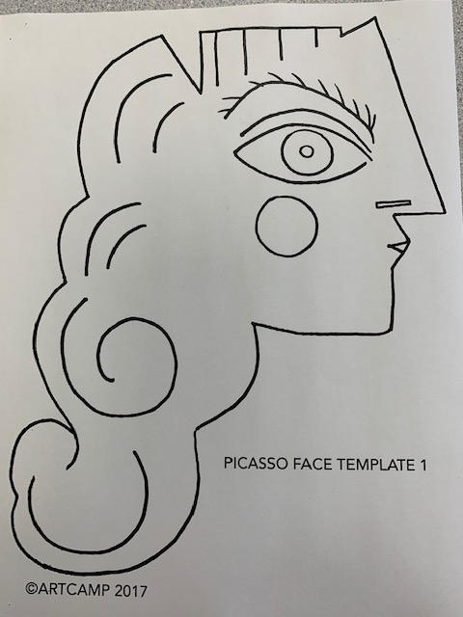
What next?
Do the same thing with the other template.

Slide 15
But what if I chose the blank templates?
Ok – if you chose the blank templates, you would follow those same steps
Now you need to add facial features to your templates. I would draw them with pencil first, make sure you like them, and then go over it with Sharpie. See example at end of ppt.

Slide 16
Coloring it
For this project I think you would want bright colors. You could use Sharpies, Watercolor Markers, or oil pastels.
Oil pastels are what we use when we do this at school as it allows for blending.
Use what you have – even if it is colored pencils or crayons.

Slide 17
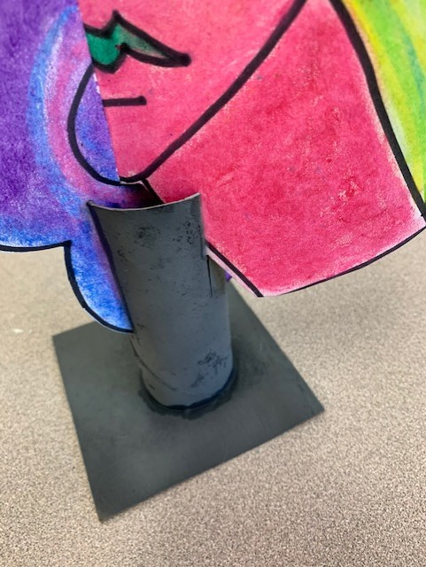
Assembly – Making the base
I used a toilet paper tube and a square of cardboard.
Cut 4 slits across from each other, at cardinal directions, in one end of toilet paper tube.
Glue the other end into the center of your square of carboard. I use 4” squares. You can use Elmers glue or hot glue for this step
After the glue is dry paint your base. At school we spray paint them.

Slide 18
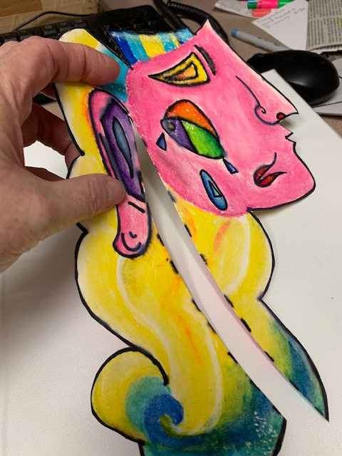
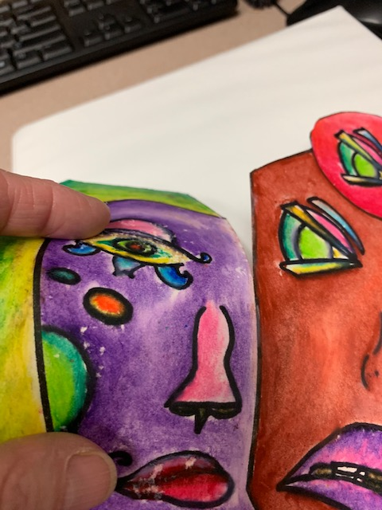
Assembly – Whole Thing
You will have to make a cut into each of your templates. See the photo.
See on the choose your own face templates where I have highlighted the cut lines.

Slide 19
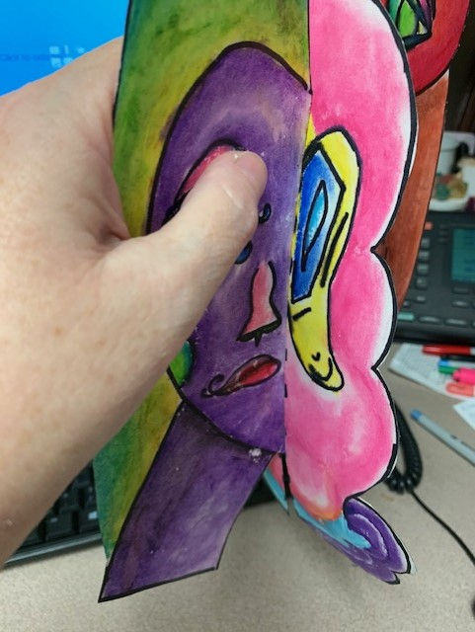
Putting it together
You are going to slide the 2 cuts together

Slide 20
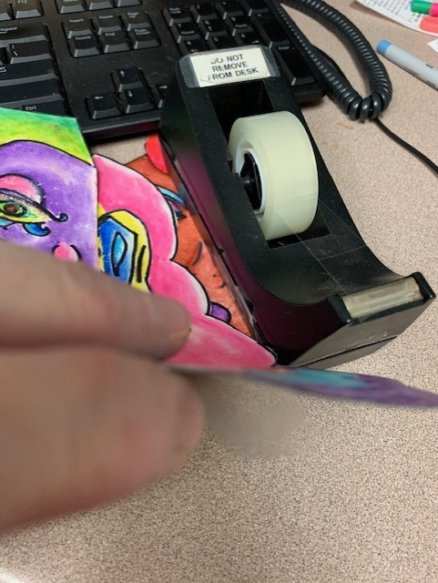
Taping the Bottom
Tape the ends of the curly hair template at the bottom of the cut
Wrap the tape around the bottom to the other side

Slide 21
Into the Base
Put your pieces into the 4 cuts in the base
The end of the curly hair will need to go into the deepest cut in your base, you may need to cut it a little deeper

Slide 22
What’s Next?
Complete your artist statement, either from my website or from Teams assignments
Take 4 pictures of your artwork, one from each side.
Attach the pictures to your artist statement and submit them as one document either in Teams assignments or email them to me.

